Slide 1

CAR ACCIDENT INDICATING SYSTEM

Slide 2
CAR ACCIDENT INDICATING SYSTEM
MENTOR
Mr. S. JAI GANESH,
Assistant Professor,
Department of Electronics and Communication Engineering,
RMK College of Engineering and Technology
AUTHORS
SHANKAR JG
SRINATH BS
SUBRAMANIAN R
YESWANTH S

Slide 3
ABSTRACT
Car accidents in India are a major concern as they lead to significant loss of life and property. With the number of vehicles on the roads increasing, the number of accidents has increased as well. It is estimated that nearly 1.5 lakh people die due to car accidents in India every year, making it one of the highest rates in the world. The most common causes for these accidents include negligent driving, over-speeding, drunk driving, mechanical failure and poor road conditions. To reduce car accident fatalities, India has implemented several initiatives such as road safety campaigns and improved traffic regulations. Additionally, automakers have been introducing new technologies such as autonomous driving systems to make roads safer for all users. Now, let us see our small innovation idea to bring up a solution to this above massacre.

Slide 4
​
In the automotive industry, impact sensors are commonly used in airbag systems to detect the severity of a collision and trigger the deployment of airbags. The sensors can also be used to detect side impacts or rollovers, which may require different airbag deployment strategies. By providing early warning of a collision, impact sensors can help reduce the risk of injury or death in a car accident. Thus, our aim is to implement impact sensor with Arduino and GSM module and NEO-6M GPS module to detect sudden changes in acceleration or motion, which are often indicative of an impact or collision. These sensors can be used in a wide variety of applications, from automotive safety to industrial monitoring to sports performance analysis. The primary goal of an impact sensor is to provide early warning of potential impacts or collisions, which can help prevent injuries or damage to equipment. ​​
By providing early warning of potential problems, impact sensors can help reduce the risk of injury or death, improve equipment reliability and efficiency, and enhance sports performance and safety. As technology continues to advance, the applications for impact sensors will likely continue to expand, leading to even greater benefits in a wide range of industries and settings.

Slide 5
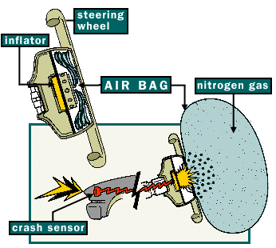
IDEA FOR THE EXECUTION
Airbags in cars are automatically opened when a car met with major accident. Airbags are opened by the action of the impact sensor which detects the impact of the accident.
When impact sensor activated the current flows into inflator and that inflates air into the airbag.
So we activate our chipset parallelly with inflator by the signal from the impact sensor.

Slide 6
BASIC FEATURES OF THIS PROJECT
In some situation airbags are opened even for the minor accident when a car get hit in front and back bumper.
So we place a switch to manually turn off the activity of our chipset that sends message to the hospitals and we alert the driver with sound that "EMERGENCY MESSAGE WILL BE SEND IN N SECONDS".
When someone not able to turn off the device within 10 seconds we comes to know that the person needs the immediate medical emergency.

Slide 7
FLOW DIAGRAM OF THE PROCESS
AIR INFLATOR
AIRBAG
GSM MODULE
IMPACT SENSOR
ARDUINO
SWITCH

Slide 8
COMPONENTS REQUIRED
Arduino UNO R3
SIM900 GSM GPRS Shield
LCD(16x2) Display
Impact and Collision Switch Sensor
NEO 6M (GPS Sensor)

Slide 9
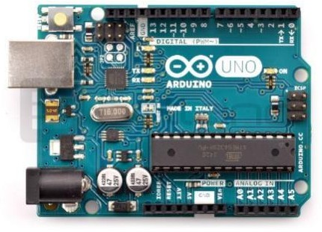
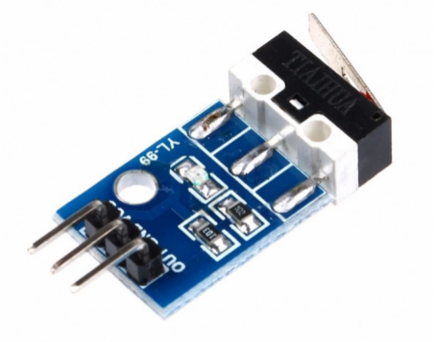
Arduino is an open source, PC paraphernalia and programming organization, endeavor, and client group that plans and produce microcontroller packs for constructing programmed devices and intelligent object that can detect and control questions in the real world. The inception of the Arduino extends began at the Interaction Design Institute in Ivrea, Italy. The equipment reference plans are appropriated under a Creative Commons Attribution Share.
Arduino UNO
Impact and Collision Switch Sensor
• The Impact Switch Collision Switch Sensor Module for Arduino is leading installation module of the collision.
• This is low output module, no high output clash. M3 License Module Easy fix hole, small car fix. With the power switch, there is a collision, fire, no lightning bumps.
It is used for detecting the collision. Therefore, it can also be called a collision signal sensor. Due to different collision direction. The crash switch can turn mechanical quantity to electricity.

Slide 10
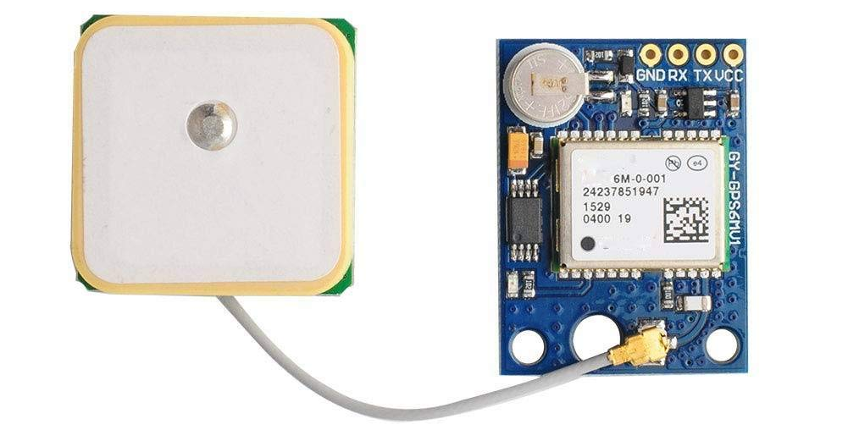
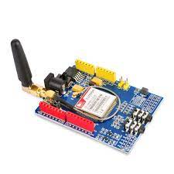
NEO-6M GPS Module
NEO-6M GPS module is the module that can track 22 satellites and identify locations anywhere in the world. It can serve as a great launch pad for anyone looking to get into the world of GPS. The module can also receive data from the satellite-based augmentation system (SBAS) to improve accuracy in areas with poor GPS signal quality.
They are low power (suitable for battery operated devices), affordable and easy to interface.
SIM900 GSM/GPRS shield
The SIM900 GSM/GPRS shield is a GSM modem that can be used in a variety of IOT projects. You can use this shield to do almost anything a normal cell phone can do, such as sending SMS messages, making phone calls, connecting to the Internet via GPRS, and much more.
To top it all off, the shield supports quad-band GSM/GPRS networks, which means it will work almost anywhere in the world.

Slide 11
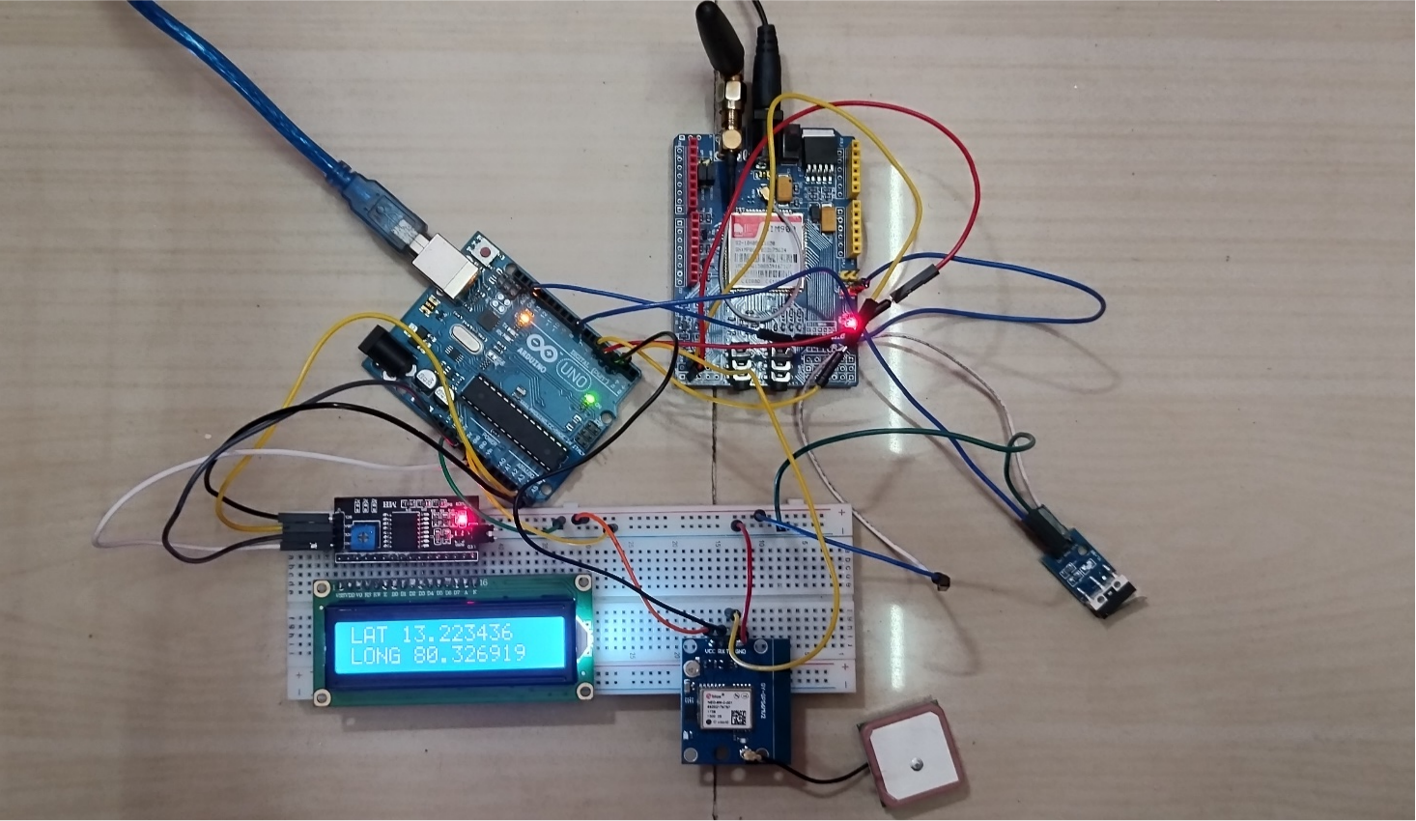
CIRCUIT CONNECTION

Slide 12
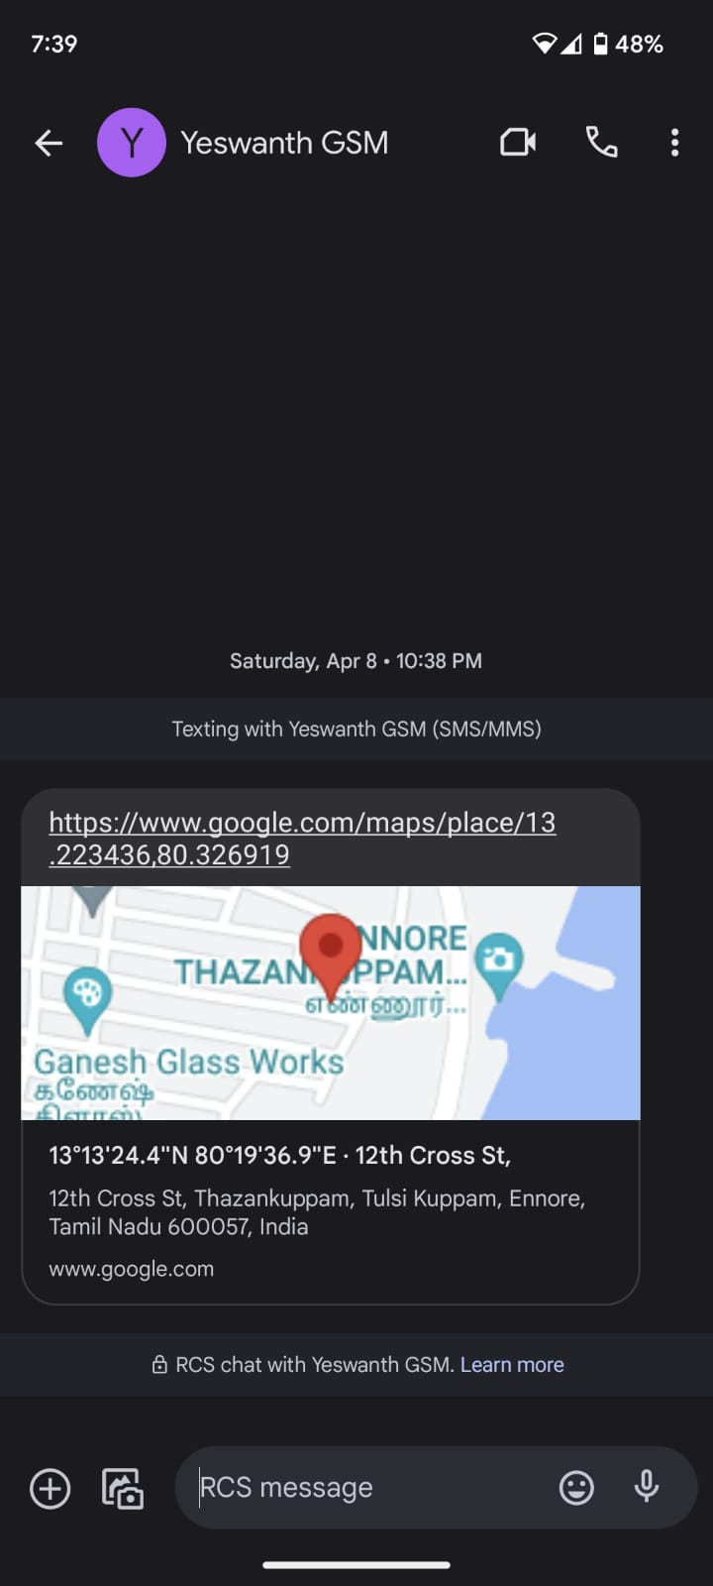
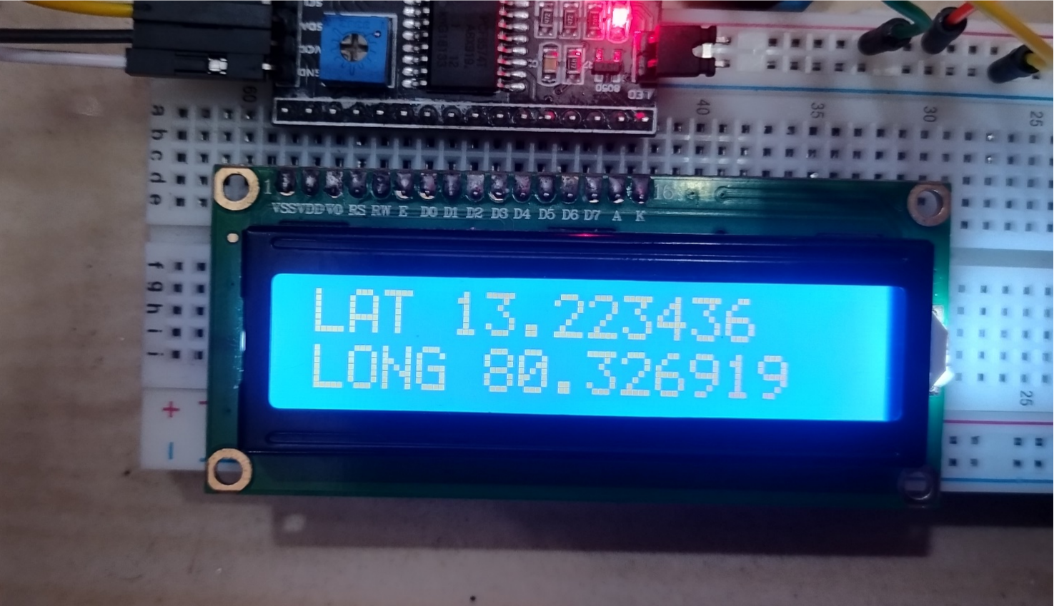
OUTPUT

Slide 13
CONCLUSION
In conclusion, the car accident indicating system using Arduino, impact and collision sensor, SIM900 GSM module, and NEO-6M GPS module is a highly effective and efficient tool for monitoring and detecting accidents in vehicles. With the ability to detect and measure the impact and collision forces, the system can accurately determine whether an accident has occurred and immediately send an alert to emergency services via the GSM module. Additionally, the system can provide the precise location of the accident using the GPS module, allowing emergency services to respond quickly and effectively.
The system is relatively easy to install and operate, making it accessible to a wide range of users. Its compact and lightweight design also ensures that it does not add any significant weight to the vehicle, making it ideal for use in various types of vehicles, including cars, trucks, and motorcycles.
Thus, the car accident indicating system using Arduino, impact and collision sensor, SIM900 GSM module, and NEO-6M GPS module is a crucial tool for improving road safety and reducing the response time of emergency services in the event of an accident. It is a cost-effective solution that can potentially save lives and minimize the damage caused by accidents.

